Slide 1

Market Movement Prediction
Presenters: Winnie Cai, Barry Murthy, Tamilselvan Tamilmani
Notes:
Barry

Slide 2
Executive Summary
Question: Can we use past market data to predict future movements in equity market?
Goal: Attempt to make sense of the market movements
Models: k-nearest neighbors, Kmeans, SVM, Random Forest, Decision Tree and Association Rules
Data sources: Yahoo Finance
Challenges: limited access to fundamental and real-time data
Requirement of trading expertise
Requirement of high computational power
Notes:
Barry

Slide 3
Table of Content
Table of Contents
Approach #1 - Lagged Return
Data Preprocessing
Exploratory Analysis
Model applications - kNN, SVM, Random Forest
Approach #2 - Technical indicators
Data Preprocessing
Exploratory Analysis
Model applications - Association Rule, K- Means, Decision Tree, SVM Linear, Random Forest
Notes:
Barry

Slide 4
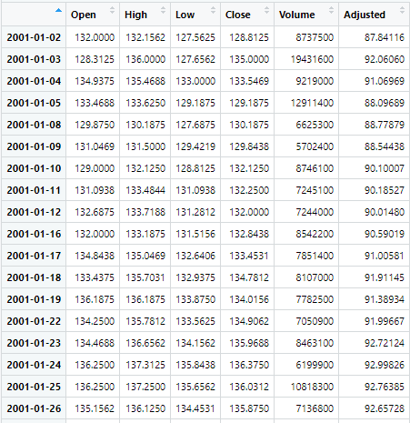
Data Set
Ticker: SPY (SPDR S&P 500 ETF Trust)
Timeline:
2001 - 2021
Frequency: daily (trading day)
Notes:
Winnie

Slide 5
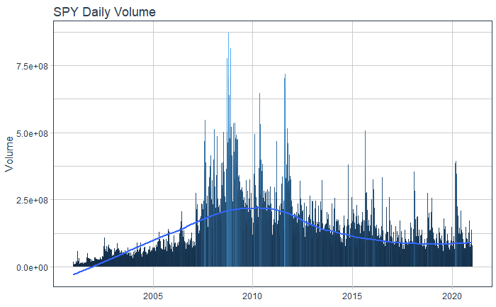
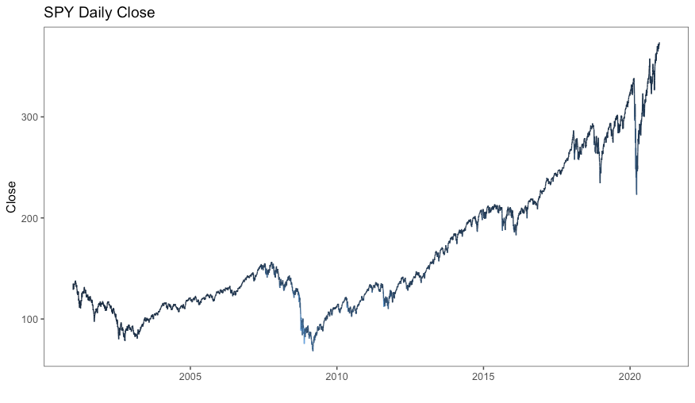
Exploratory Analysis
Notes:
Winnie

Slide 6
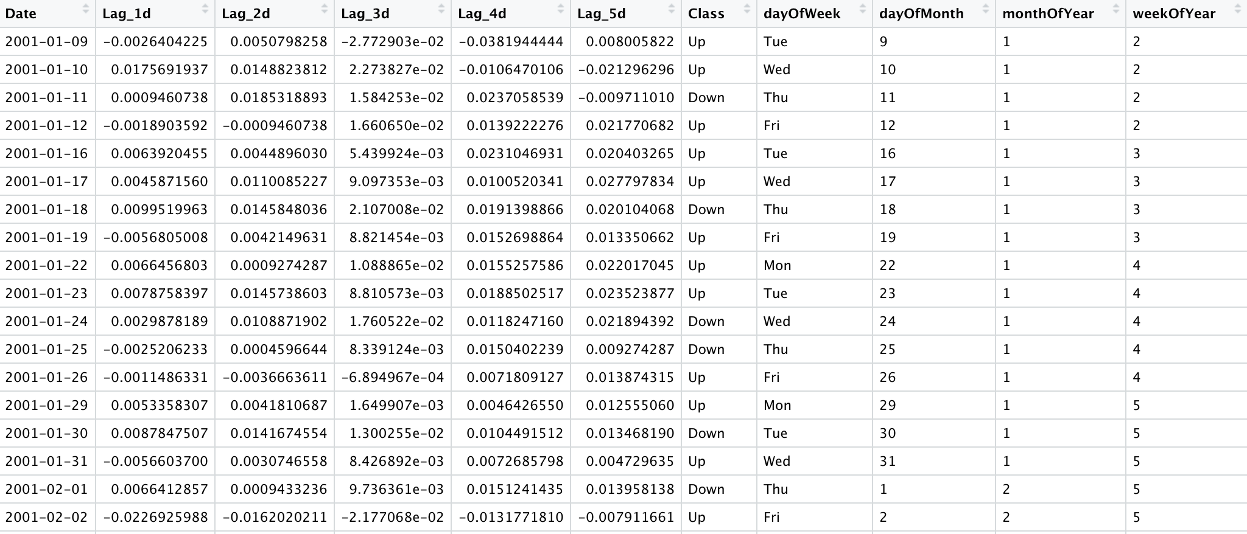
Data Preprocessing
Calculate lagged returns to avoid look-ahead bias
Label day of week, month and year, etc.
Create a ‘Class’ column based on 1-day return
Notes:
Winnie

Slide 7
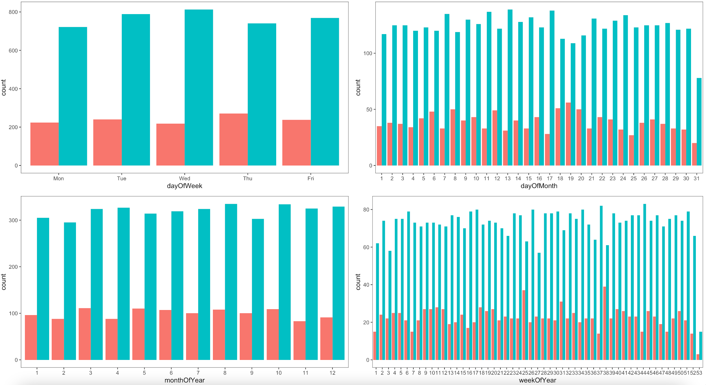
Market Movement
Notes:
Winnie

Slide 8
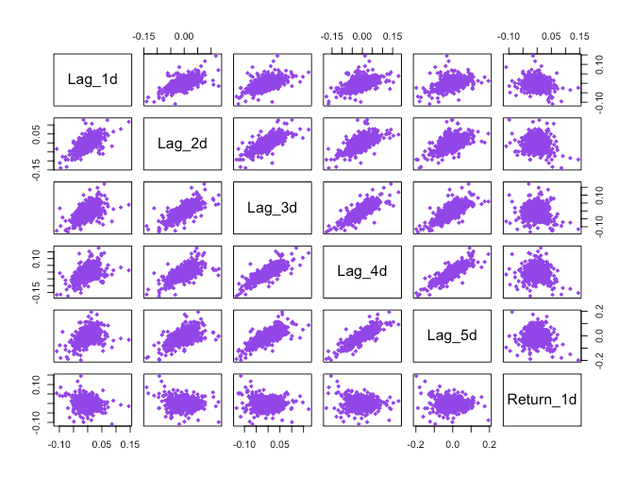
Correlation
Notes:
Winnie

Slide 9
Modeling
Training data set:
2001 - 2017
Testing data set:
2018 - 2020
Cross Validation: 5 folds
Approach #1: Lagged Returns
Notes:
Winnie

Slide 10
Lagged Returns
Lagged 1-day return, Lagged 2-day return, Lagged 3-day return, Lagged 4-day return, Lagged 5-day return
Notes:
Winnie

Slide 11
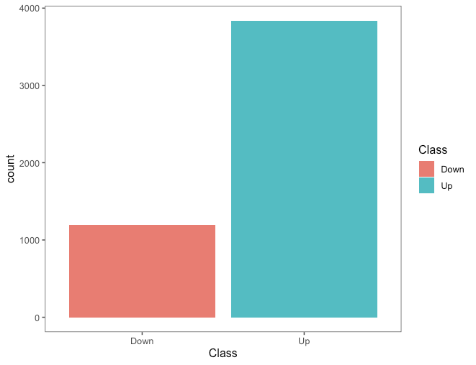
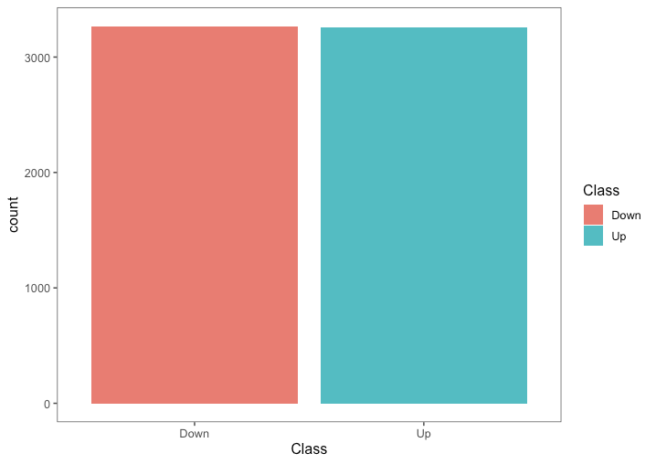
Data Preprocessing - Create a balanced training data set via
Adaptive Synthetic Sampling Approach
Notes:
Winnie

Slide 12
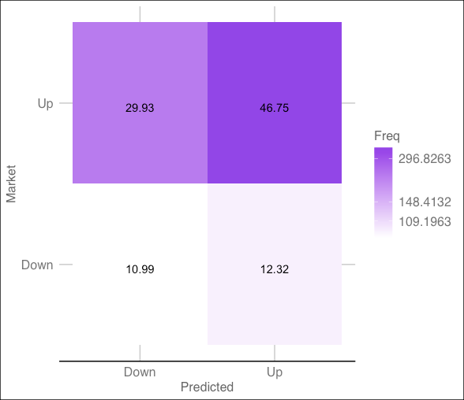
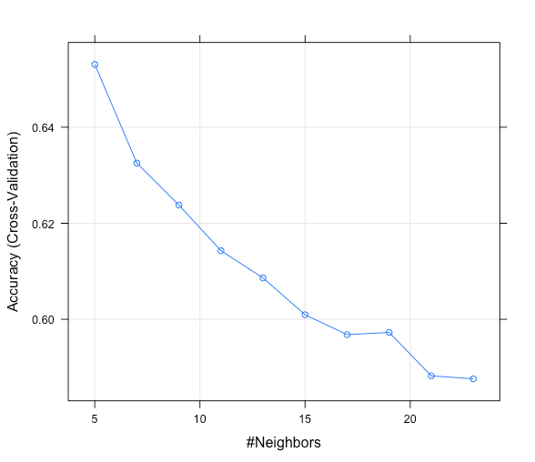
kNN
Highest accuracy at K=5
Notes:
Tamil

Slide 13
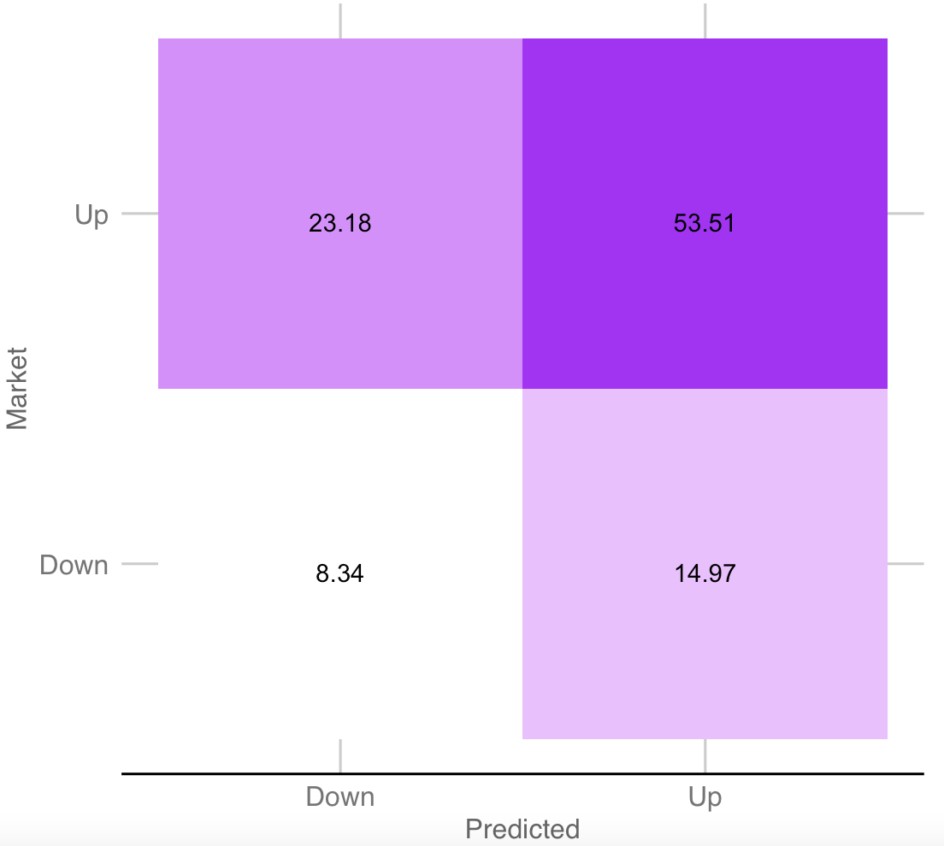
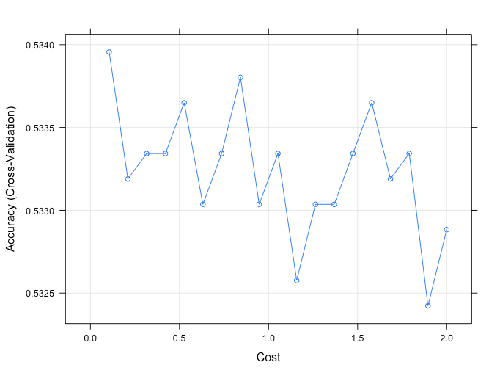
SVM Linear
Performed better on back testing , with 53% accuracy
Notes:
Tamil

Slide 14
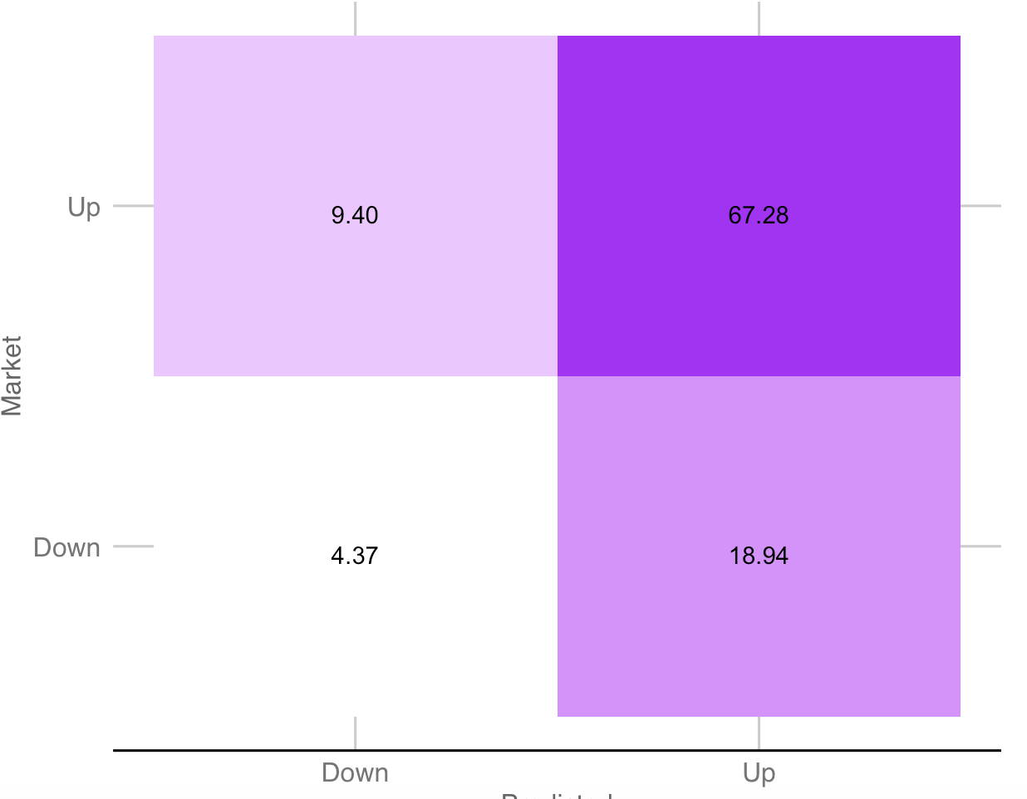
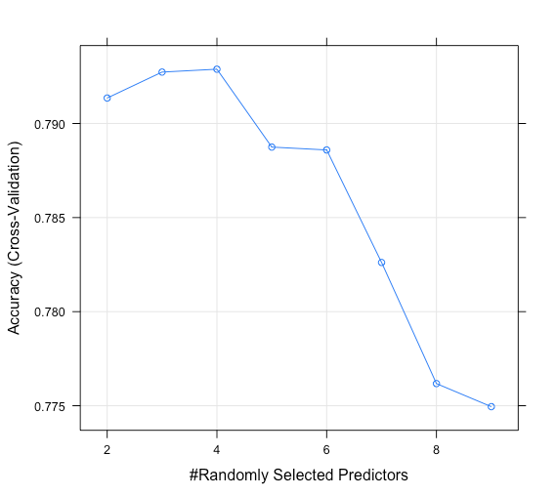
Random Forest
53% accuracy in back testing
Notes:
Tamil

Slide 15
Observation
All the models kNN, Random Forest and SVM just predicted the dominating class and the balanced accuracy at around 50+%
Notes:
Tamil

Slide 16
Modeling
Training data set:
2001 - 2017
Testing data set:
2018 - 2020
Cross Validation: 5 folds
Approach #2: Technical Indicators
Notes:
Winnie

Slide 17
Technical Indicators
RSI: relative strength index
SMA: 5-day moving average
LMA: 50-day moving average
ADX: Welles Wilder's Directional Movement Index
Notes:
Winnie

Slide 18
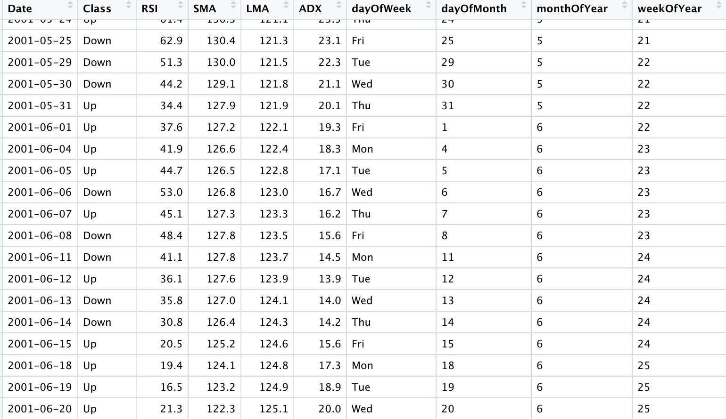
Data Preprocessing
Notes:
Winnie

Slide 19
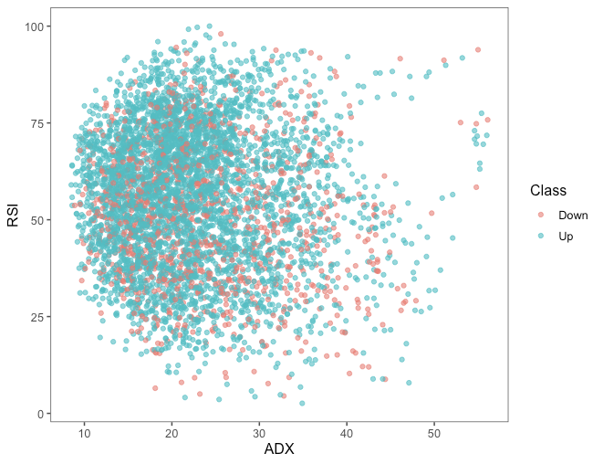
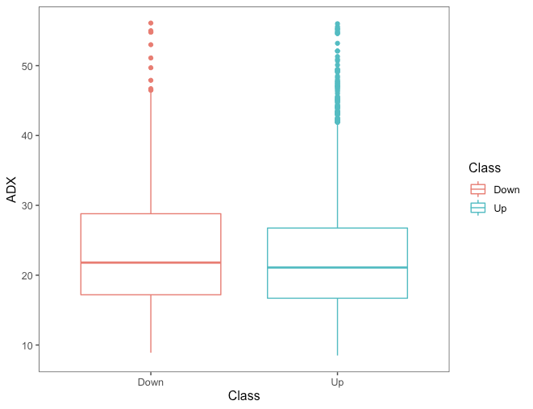
Exploratory Analysis
Notes:
Winnie

Slide 20
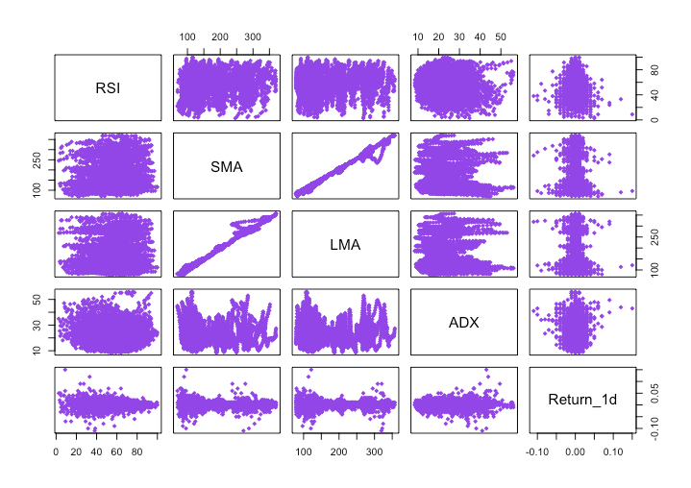
Correlation
Notes:
Winnie

Slide 21
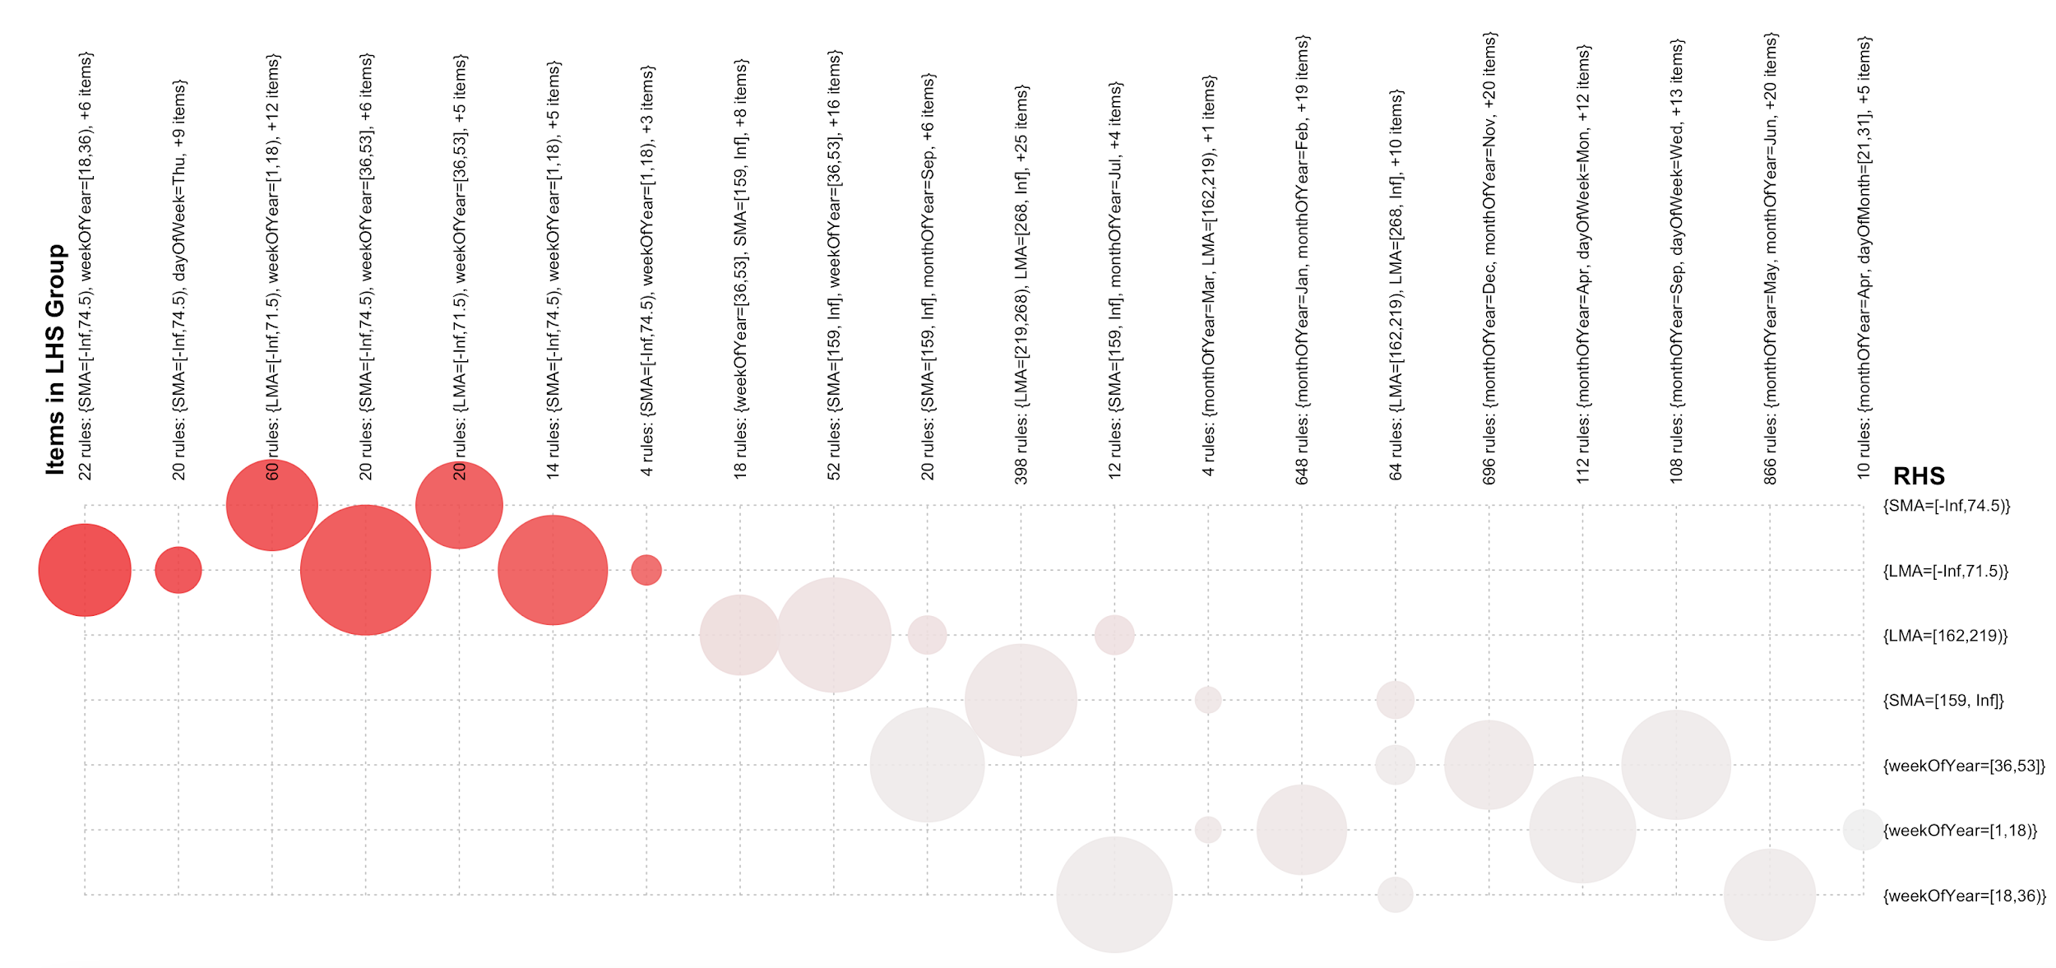
Association Rules
Strong lift for Lower Band LMA & SMA with the weeks 1,18,36, 53
Notes:
Tamil

Slide 22
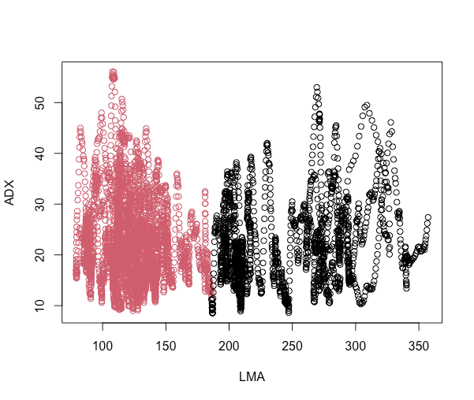
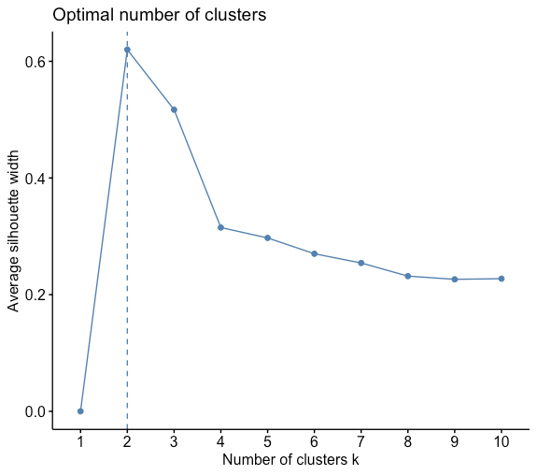
K-Means
Notes:
Tamil

Slide 23
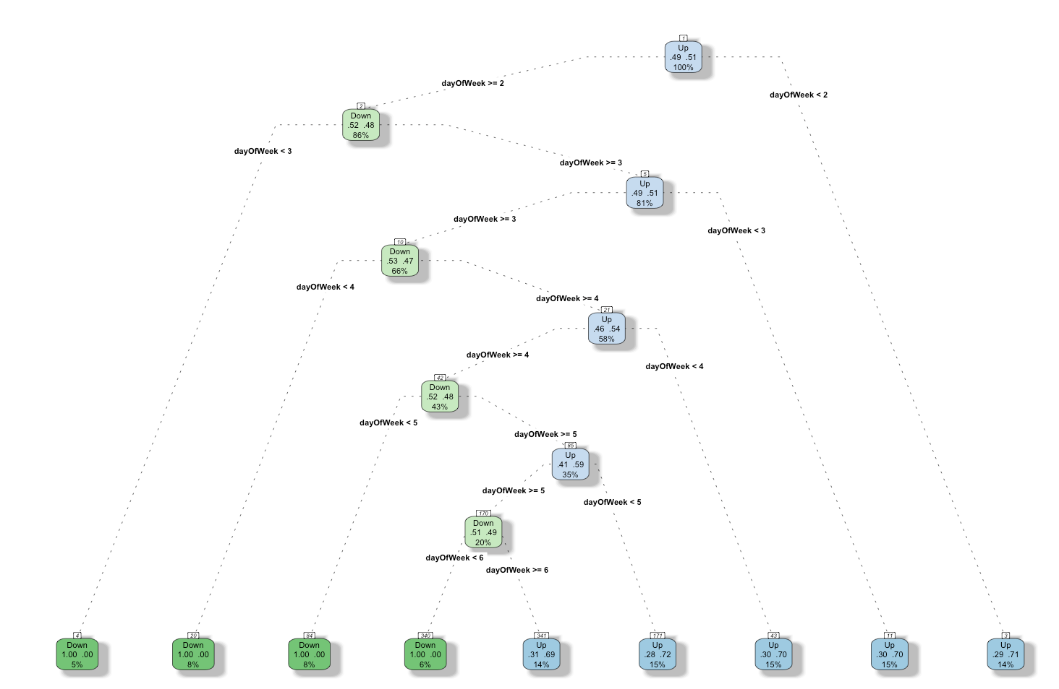
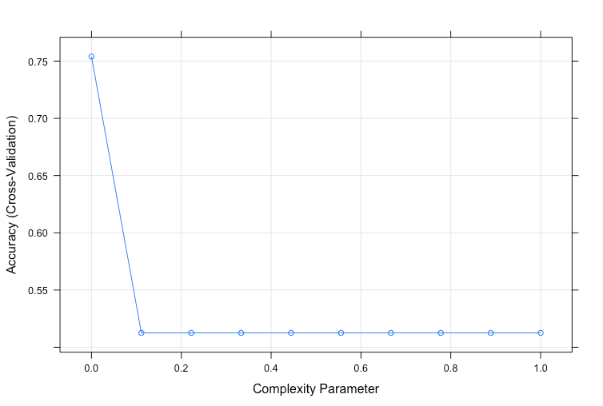
Decision Tree
Notes:
Tamil

Slide 24
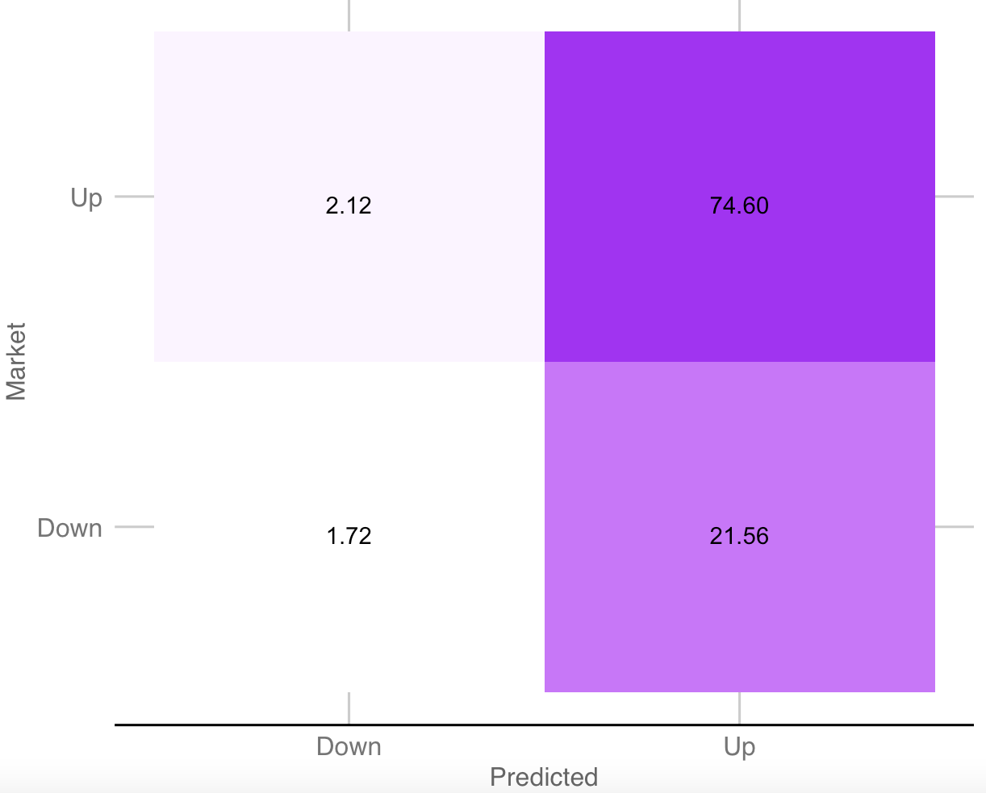
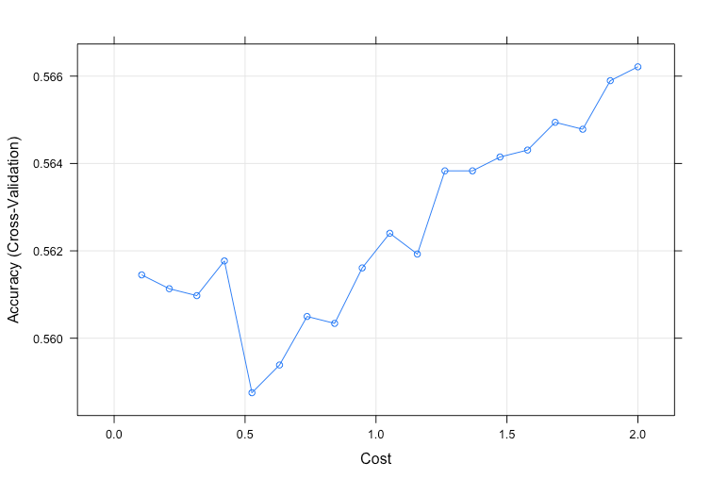
SVM Linear
Notes:
Tamil

Slide 25
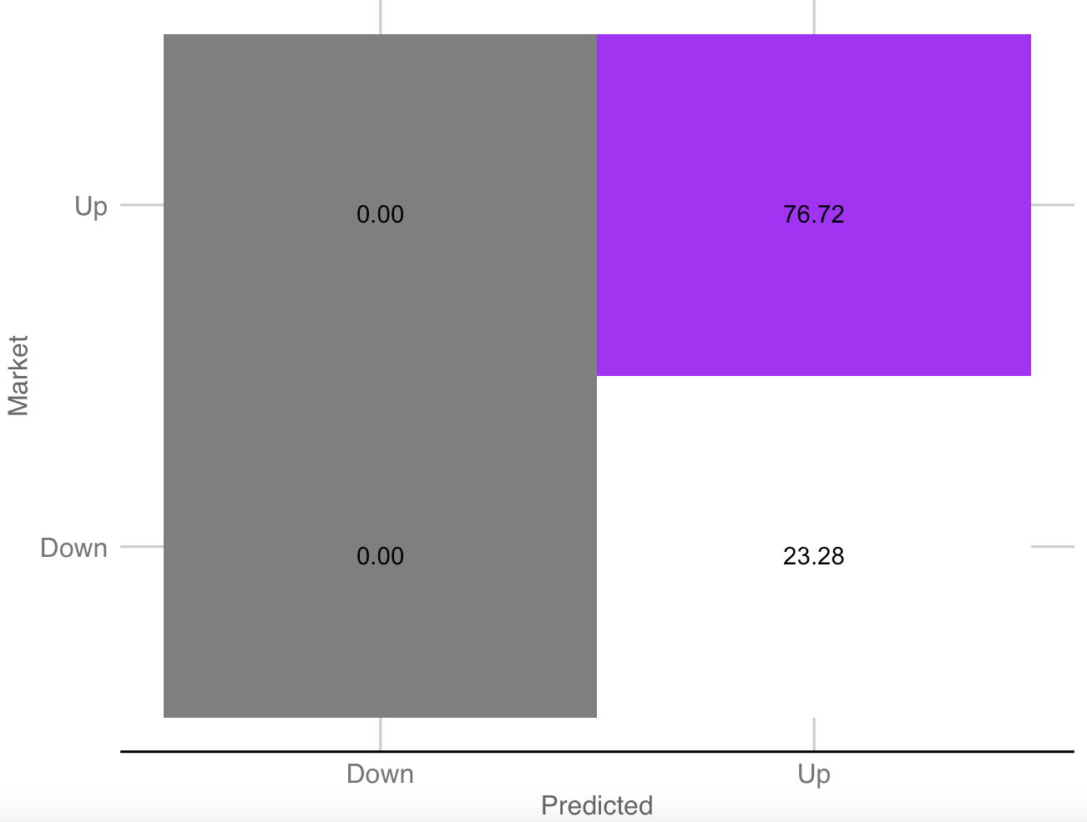
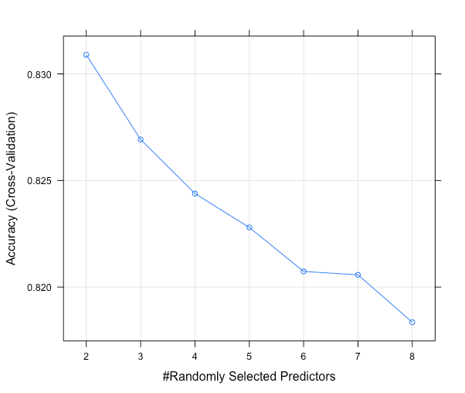
Random Forest
High Training Accuracy
But just ended up predicting the majority class alone
Notes:
Tamil

Slide 26
Conclusion
We explored two different approaches using different calculated metrics,via a series of machine learning algorithms, we came to the same conclusion - the past market data is not useful for future equity market movement prediction
Through comprehensive exploratory analysis, we observed that the technical indicators are not very useful to categorize the market directions
All of the observations throughout the project seem to align with the Weak-form market efficiency hypothesis
Notes:
Barry

Slide 27
What’s Weak-form Market Efficiency Hypothesis?
The hypothesis states that current security price fully reflect all currently available security market data. Thus, past price and volume (market) information will have no predictive power about the future direction of security prices.
Notes:
Barry

Slide 28

Questions?
Notes:
Barry /everyone

